Slide 1
NYC Shooting Cluster Analysis
By Pritam Das

Slide 2
Index
Title
Slide No
Objective
Data Source
Technologies used
Methodology
Model performance
Cluster visualization
Conclusion
Future scope
3
4
5
6
7
8
9
10

Slide 3
Objective
Develop a machine learning model to cluster NYC shooting incidents
Analyze incidents based on time, location, demographics, and jurisdiction
Identify patterns and hidden dynamics of gun violence
Support law enforcement in tailoring interventions and strategies
Promote data-driven decision-making for improved public safety

Slide 4
Data Source
Dataset:
  NYPD_Shooting_Incident_Data__Historic_.csv
Contains shooting incident records like:
  Date, Time, and Borough of incident
  Victim and perpetrator demographics (age, sex, race)
  Location details (precinct, jurisdiction, latitude and longitude)
  Weapon used
  Arrest information and outcome

Slide 5
Technologies used
Python: Data preprocessing, model experimentation
Jupyter Notebook: For model development (model.ipynb)
Machine Learning: K-Means Clustering for clustering shooting incedents
Power BI: Data visualization and interactive dashboard (NYPD_Shooting_Incident_Dashboard.pbix)
Libraries Used: pandas, numpy, scikit-learn, matplotlib, seaborn, cloudpickle, dill

Slide 6
Methodology
Data Preparation
  Loaded NYPD_Shooting_Incident_Data__Historic_.csv
  Dropped irrelevant cols (INCIDENT_KEY, LOC_CLASSFCTN_DESC, LOC_OF_OCCUR_DESC, Lon_Lat)
  Removed invalid age codes (1020, 1022), handled nulls (mode/mean), dropped duplicates
Preprocessing
  Encoded categorical variables with LabelEncoder
  Standardized features with StandardScaler
  Applied PCA (2 components) for dimensionality reduction
Modeling and Evaluation
  KMeans clustering (k = 2–100)
  Evaluated with Inertia (Elbow) and Silhouette Score
  Selected best cluster size, retrained final KMeans

Slide 7
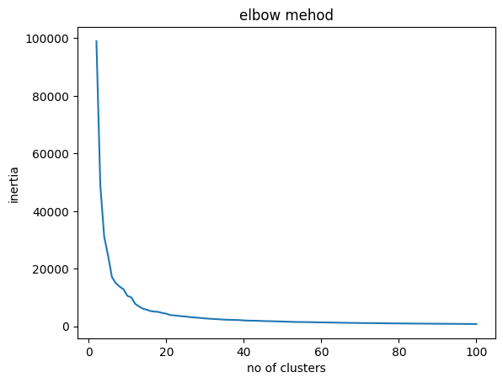
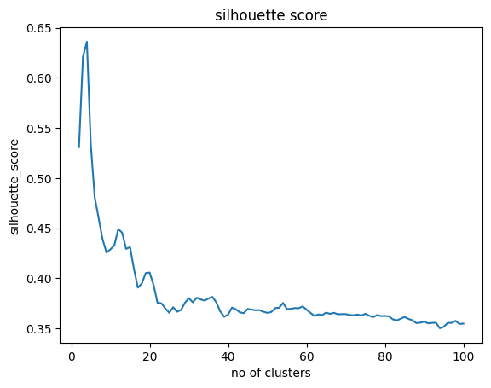
Model Performance
best no of cluster: 4
silhouette score for the cluster: 0.6360330632146993
inertia for the cluster: 31138.054773960015

Slide 8
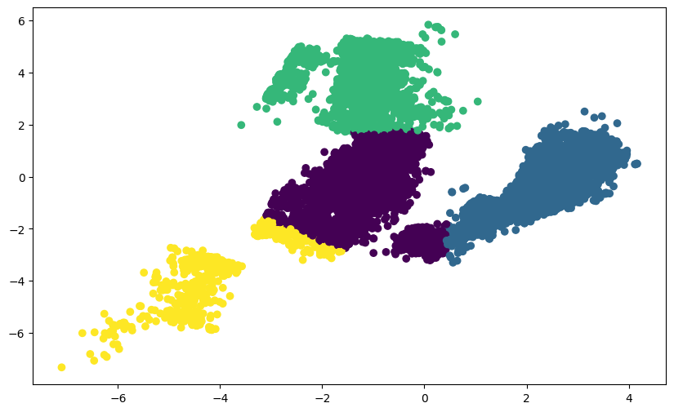
Cluster Visualization

Slide 9
Conclusion
Conducted data cleaning and preprocessing on NYPD shooting incident dataset
Applied PCA for dimensionality reduction
Built and evaluated KMeans clustering (k = 2–100)
Identified optimal clusters using Silhouette and Elbow methods
Developed a Power BI dashboard for interactive visualization
Project demonstrates how ML + BI tools can uncover hidden crime patterns

Slide 10
Future Scope
Extend dataset with recent/live NYPD data for real-time analysis
Apply advanced clustering methods (DBSCAN, Gaussian Mixture Models)
Integrate geospatial analysis (crime hotspots and trends by location)
Use predictive modeling for crime forecasting
Deploy as a web/streamlit app for broader accessibility
Expand methodology for other cities/crime datasets

Slide 11

Feedback
Please give me feedback of my project.
Your feedback will encourage and motivate me.
Click here for feedback form

Slide 12
Thank you..

